Slide 1
Fuzzy Logic Application
Making an Artificial Pancreas for
People with Type I Diabetes
Glen Browne
EE 476
California State University, Long Beach
May 5, 2018
Professor Chit-Sang Tsang

Slide 2
Background:
Type I Diabetes, also known as “insulin-dependent diabetes,” or “juvenile diabetes,” results from the pancreas’ inability to produce enough insulin. Insulin is a critical hormone that regulates the amount of glucose in the blood. The presence of insulin in the blood triggers anabolic metabolism, or the conversion of glucose in the blood to muscle and fat. A lack of insulin prevents anabolic processes in the body, causing loss of muscle tissue and overall weight loss. The ratio of insulin to glucose level in the blood must be kept at a proper level to allow the body to function properly. A fuzzy-logic based automated insulin pump can be used to efficiently manage Type I Diabetes by monitoring the levels of insulin and glucose in the blood, and taking corrective action by introducing correct amounts of insulin into the blood when necessary.

Slide 3
Traditional Treatment vs. Fuzzy Logic Control
Traditionally:
Patient measures blood glucose concentration manually by pricking finger and using testing hardware.
Patient decides how much Insulin to inject
Fuzzy Logic:
System periodically measures blood glucose levels and automatically supplies the proper level of insulin

Slide 4
Fuzzy Logic Advantages:
Patient doesn’t have to worry about monitoring blood glucose concentration or injecting insulin; it’s done automatically.
The correct amount of insulin is always supplied:
Food is properly utilized by the body
Prevents insulin overdose, which causes hypoglycemia (low blood sugar)

Slide 5
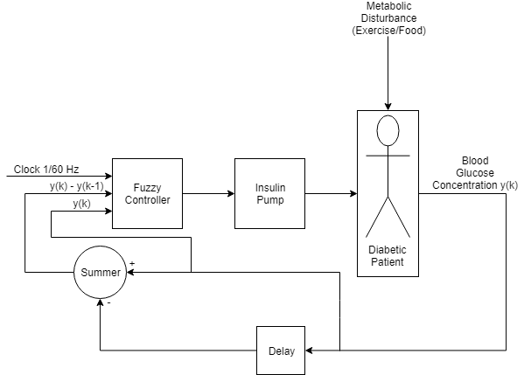
Artificial Pancreas System Model

Slide 6
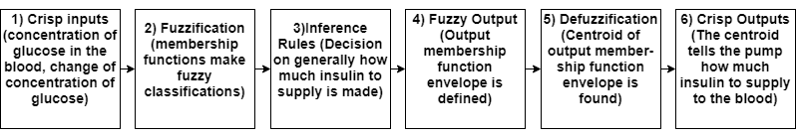
Fuzzy Logic Controller

Slide 7
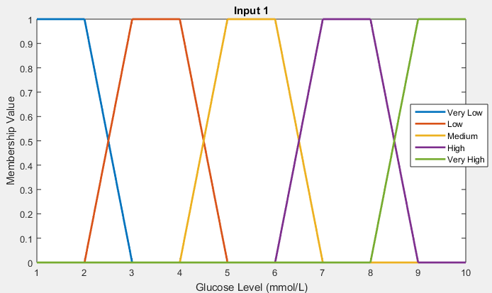
System Input 1:
Blood Glucose Concentration
Membership Function Outlines:
Very Low: 0-3 mmol/L
Low: 2-5 mmol/L
Medium: 4-7 mmol/L
High: 6-9 mmol/L
Very High: 8+ mmol/L

Slide 8
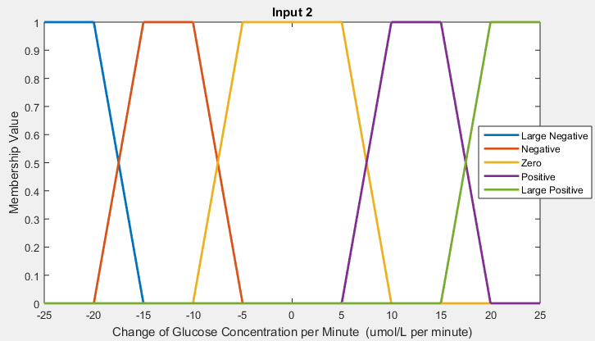
System Input 2:
d/dt of Blood
Glucose Concentration
Membership Functions Outlines:
Large Neg: < -15 umol/L / min
Negative: -20 to -5 umol/L / min
Zero: -10 to 10 umol/L / min
Positive: 5 to 20 umol/L / min
Large Pos: > 15 umol/L / min

Slide 9
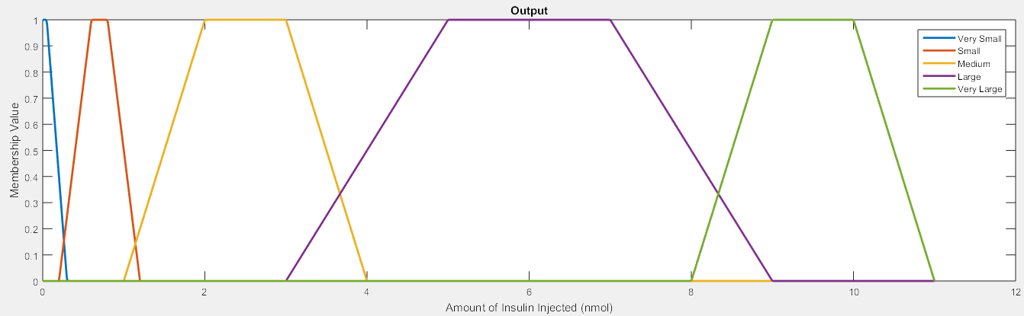
System Output:
Amount of Insulin Pumped
Membership Function Outline:
Very Small: 0.05-0.3 nmol Small: 0.2-1.2 nmol
Medium: 1-4 nmol Large: 3-9 nmol
Very Large: 8-11 nmol

Slide 10
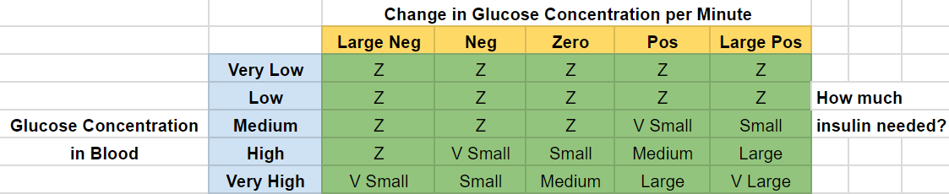
Fuzzy Associative Memory Table

Slide 11
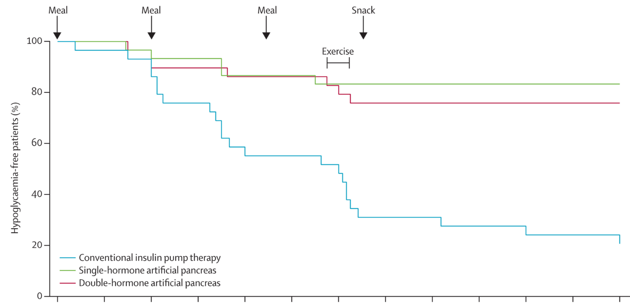
Results: Hypoglycemia Greatly Reduced

Slide 12
Conclusion
A fuzzy logic-based artificial pancreas is better than conventional insulin therapy for many reasons.
Hassle-Free and automatic; saves time and worry
Prevents overdosing on insulin which leads to hypoglycemia and insulin resistance
More effectively manages overall metabolism
Overall better quality of life

Slide 13
Sources
https://www.thelancet.com/journals/landia/article/PIIS2213-8587(14)70226-8/fulltext
https://en.wikipedia.org/wiki/Diabetes_mellitus
https://en.wikipedia.org/wiki/Hypoglycemia
https://www.ncbi.nlm.nih.gov/pubmed/23829285
https://www.sciencedirect.com/science/article/pii/S1350453306001834

